Slide 1


Choose the right cover page, delete the other cover page
Delete this red box before sending to customer
WaveMark™
Supply Management and Workflow Solutions
Business review

Slide 2
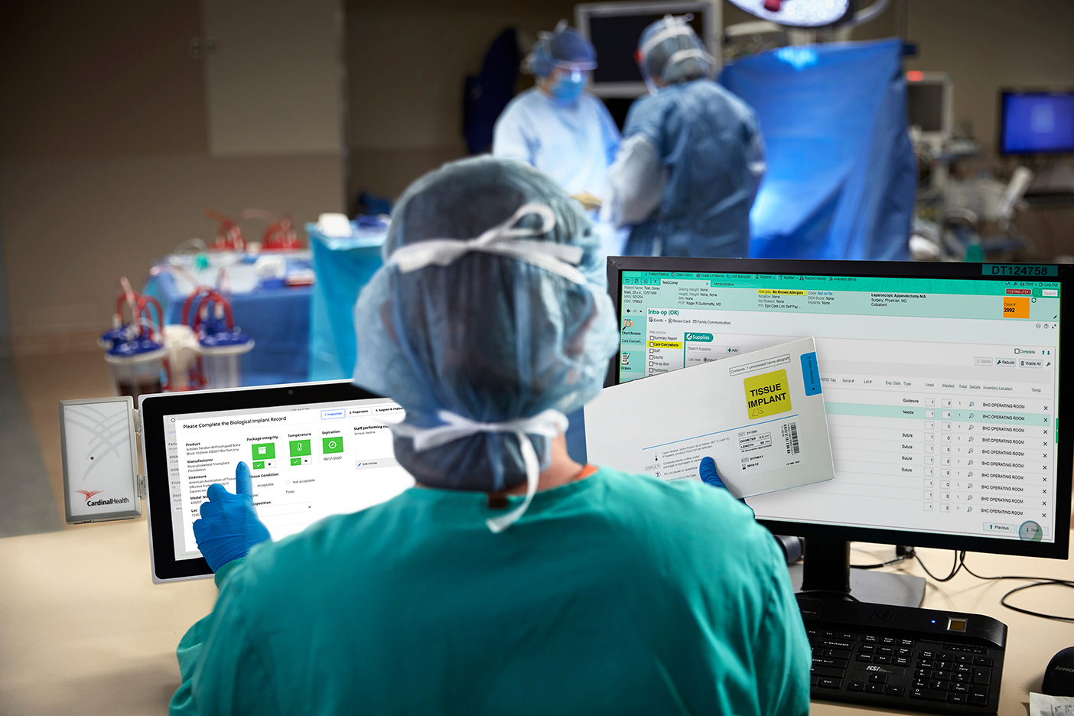
Choose the right cover page, delete the other cover page
Delete this red box before sending to customer
WaveMark™
Supply Management and Workflow Solutions
Business review

Slide 3









Executive Summary
v
Greater value +1.8% inventory (+$364K) -42bps expiration (-$58K) -270bps waste (-$235K) | Patient experience Clinical time savings POU for expired & recalled
Accurate clinical documentation -179bps documentation after case (-$53K) Clinical satisfaction | Enterprise visibility 1.60 manufacturers per product types 24% SKU consumption Product performance by manufacturer Proactive and prescriptive analytics Accurate real-time supply data
+$200K
YTD ROI
Modify this slide to include all metrics (use red/green to indicate what improved and what worsened)
Update Journey (where departments fall in each bucket), ROI, and add commentary – Journey helps contextualize all the metrics
Delete this red box before sending to customer
[Use this space for commentary / highlights]
Metric improved / better than benchmark
Metric worsened / worse than benchmark
Hypercare
5 departments
Standardize
5 departments
Optimize
Hospital / Dept 5
Implement
50 departments
The Journey

Slide 4
Effectiveness metrics

Slide 5
Update # Rooms in data file
Update recommendation (blue box)
Update key takeaways (grey box)
Delete this red box before sending to customer
Optimizing inventory reduces waste and write-offs
Total inventory, [Customer name] enterprise
Recommendation: Evaluate SmartPar recommendations on a weekly basis for added savings
Key takeaways
[Is this good or bad?]
[What have you been doing to help them with this metric?]
[What help do you still need from the customer to help with this metric?]
[If on hand inventory is going up, look into encounters to see if it’s the reason. Be prepared to discuss inventory per encounter, as well.]
[Note: Explain to customer that in every case, you want to be below the benchmark]
More details in Appendix, slides ___ - ___
*Benchmark based on internal WaveMark data (all customers)

Slide 6
Update recommendation (blue box)
Update key takeaways (grey box)
Delete this red box before sending to customer
Optimizing inventory reduces waste and write-offs
Total inventory, [Customer name] enterprise
Recommendation: Evaluate SmartPar recommendations on a weekly basis for added savings
Key takeaways
[Is this good or bad?]
[What have you been doing to help them with this metric?]
[What help do you still need from the customer to help with this metric?]
[If on hand inventory is going up, look into encounters to see if it’s the reason. Be prepared to discuss inventory per encounter, as well.]
More details in Appendix, slides ___ - ___
*Benchmark based on internal WaveMark data (all customers)

Slide 7
Update recommendation (blue box)
Update key takeaways (grey box)
Delete this red box before sending to customer
Optimizing inventory reduces waste and write-offs
Total inventory, [Customer name] enterprise
Recommendation: Evaluate SmartPar recommendations on a weekly basis for added savings
Key takeaways
[Is this good or bad?]
[What have you been doing to help them with this metric?]
[What help do you still need from the customer to help with this metric?]
[If on hand inventory is going up, look into encounters to see if it’s the reason. Be prepared to discuss inventory per encounter, as well.]
More details in Appendix, slides ___ - ___
*Benchmark based on internal WaveMark data (all customers)

Slide 8
Update recommendation (blue box)
Update key takeaways (grey box)
Delete this red box before sending to customer
Optimizing inventory reduces waste and write-offs
Total inventory, [Customer name] enterprise
Recommendation: Evaluate SmartPar recommendations on a weekly basis for added savings
Key takeaways
[Is this good or bad?]
[What have you been doing to help them with this metric?]
[What help do you still need from the customer to help with this metric?]
[If on hand inventory is going up, look into encounters to see if it’s the reason. Be prepared to discuss inventory per encounter, as well.]
More details in Appendix, slides ___ - ___
*Benchmark based on internal WaveMark data (all customers)

Slide 9
Update recommendation (blue box)
Update key takeaways (grey box)
Delete this red box before sending to customer
Reducing expiration leads to increased profitability and patient safety
Expiration, [Customer name] enterprise
Recommendation: None
Key takeaways
[Is this good or bad?]
[What have you been doing to help them with this metric?]
[What help do you still need from the customer to help with this metric?]
[Investigate why]
[Be ready to discuss this as a % of total inventory, how sales used to present it]
More details in Appendix, slides ___ - ___
*Benchmark based on internal WaveMark data (all customers)

Slide 10
Update recommendation (blue box)
Update key takeaways (grey box)
Delete this red box before sending to customer
Reducing expiration leads to increased profitability and patient safety
Expiration, [Customer name] enterprise
Recommendation: None
Key takeaways
[Is this good or bad?]
[What have you been doing to help them with this metric?]
[What help do you still need from the customer to help with this metric?]
[Investigate why]
[Be ready to discuss this as a % of total inventory, how sales used to present it]
More details in Appendix, slides ___ - ___
*Benchmark based on internal WaveMark data (all customers)

Slide 11
Update recommendation (blue box)
Update key takeaways (grey box)
Delete this red box before sending to customer
Non-productive use of supplies erodes profitability
Wasted supplies, [Customer name] enterprise
Recommendation: None
Key takeaways
[Is this good or bad?]
[What have you been doing to help them with this metric?]
[What help do you still need from the customer to help with this metric?]
More details in Appendix, slides ___ - ___
*Benchmark based on internal WaveMark data (all customers)

Slide 12
Update recommendation (blue box)
Update key takeaways (grey box)
Delete this red box before sending to customer
Non-productive use of supplies erodes profitability
Wasted supplies, [Customer name] enterprise
Recommendation: None
Key takeaways
[Is this good or bad?]
[What have you been doing to help them with this metric?]
[What help do you still need from the customer to help with this metric?]
More details in Appendix, slides ___ - ___
*Benchmark based on internal WaveMark data (all customers)

Slide 13
Update recommendation (blue box)
Update key takeaways (grey box)
Delete this red box before sending to customer
Reduce missing documentations and capture more potential revenue, improve inventory accuracy for better insights
Accurate supply documentation, [Customer name] enterprise
Recommendation: Clean up item master for more automated documentation of supplies
Key takeaways
[Is this good or bad?]
[This department/hospital is doing really well, but it’s this one that needs some help]
[What have you been doing to help them with this metric?]
[What help do you still need from the customer to help with this metric?]
More details in Appendix, slides ___ - ___
*Benchmark based on internal WaveMark data (all customers)

Slide 14
Update recommendation (blue box)
Update key takeaways (grey box)
Delete this red box before sending to customer
Reduce missing documentations and capture more potential revenue, improve inventory accuracy for better insights
Accurate supply documentation, [Customer name] enterprise
Recommendation: Clean up item master for more automated documentation of supplies
Key takeaways
[Is this good or bad?]
[This department/hospital is doing really well, but it’s this one that needs some help]
[What have you been doing to help them with this metric?]
[What help do you still need from the customer to help with this metric?]
More details in Appendix, slides ___ - ___
*Benchmark based on internal WaveMark data (all customers)

Slide 15
Modify this slide to meet the needs of your QBR
Delete this red box before sending to customer
Calls to action
01
02
03
04
Share
Use the tools
Engage
Ask questions
Share feedback from your customers so we can continue to improve the work
If customers ask for different metrics, share those with me
Refer to Teams for the latest templates every time you use them
WaveMark Warehouse >
Product Management and Marketing >
Marketing >
Benchmarks folder
Reach out to me for nuanced benchmarks based on various demographics
(CMI, payor mix, encounter volumes, case types, etc.)
If something doesn’t make sense or you need help, reach out anytime for support!

Slide 16
Thank You

Slide 17
Other metrics that the customer may care about
Added this as a placeholder to put in other metrics the customer may care about
Could also use this space to show key metrics by each department, if that’s helpful
Delete this red box before sending to customer

Slide 18
Keep and update, if needed. Delete if not
Delete this red box before sending to customer
Customer Relationship Summary – Example
Contracts | Hospitals | Departments
1 | 2 | 3
Interventional Lab
Start Date: |  | End Date
Cabinets | Off-Cabinet | POU | Smart Wands | Interfaces
EP Lab
Start Date: |  | End Date
Cabinets | Off-Cabinet | POU | Smart Wands | Interfaces

Slide 19
Keep and update, if needed. Delete if not
Delete this red box before sending to customer
Interfaces
PurchaseLink
Connects to Lawson. Automates and optimizes supply reordering. Supports advanced reordering features such as bill only, bill and replace, rush order, and bulk buy
ItemMasterLink
Connects to Lawson. Synchronizes item master data, eliminates manual data entry, and improves data quality
Barcode Connect
Product usage information flows into Hemodynamic System or Epic. Eliminates manual processes and data duplication
DataLink
Feeds raw data out of WaveMark into your own Analytics system to allow for customization of reporting and visibility to the data from WaveMark.
ORLink (Future Opportunity)
Utilizes ADTLink functionality for scheduling. Allows for communication between WaveMark and Epic Optime in OR for supply transfers to prevent double documentation.

Slide 20
How metrics are calculated
Value Pillars | Metrics | Definitions / Equations* | Notes
Greater value | Reduce inventory | = On Hand Inventory / # Rooms | Blended from WaveMark installs By department type (OR vs. procedural) By ownership (owned vs. consigned) Previously measured relative to # of encounters
 | Reduce expiration | = Expiration Cost / On Hand Inventory | Includes ONLY purchased items and RFID tracked products Previously measured relative to Used products
 | Reduce waste | = ([Opened-Not Used Cost] + [Opened-Wasted Cost] + [Lost Cost] + [Obsolete Cost]) / ([Scanned to Patient Cost] + Patient Cost) | Includes only controllable waste Does NOT include expired, loaned, missing, recalled, defective, returned, transferred
Accurate clinical documentation | Reduce documentation corrections post case | = [Patient Cost] / ([Scanned to Patient Cost] + [Patient Cost]) | Inverse of POU Compliance rate Shifted to focus all metrics on driving down
Enterprise visibility | Reduce manufacturers per product type | = # manufacturers / # product types | Uses SKU metric to determine what manufacturers and product types were available and used during a given time period SKUs include any UPNs ordered, in inventory or used
 | Improve SKU consumption | = # SKUs consumed / # SKUs available | SKUs include any UPNs ordered, on hand or used Narrowed to include ONLY RFID tracked products

